Slide 1
Digging into Metadata (abridged)
Michael Khoo, Xia Lin, Jae-wook Ahn
Drexel University, USA
Ceri Binding, Douglas Tudhope
Hypermedia Research Unit, University of South Wales, UK
Diana Massam, Hilary Jones
MIMAS, University of Manchester, UK
Digging Into Data Program Meeting, Montreal, October 12, 2013

Slide 2
Metadata Connects Data
Problem space
Plenty of metadata in DLs, but usually in silos
Aim
Federated discovery across heterogeneous DLs
Educational DLs, Dublin Core metadata
Support easy cross-DL browsing
Method
Harvest metadata into central bucket
Run text analysis across metadata fields in each record (title, subject, description) and extract terms
Use terms to generate DDC for each record
Develop search/browse tools to run across the new DDC in the augmented bucket

Slide 3
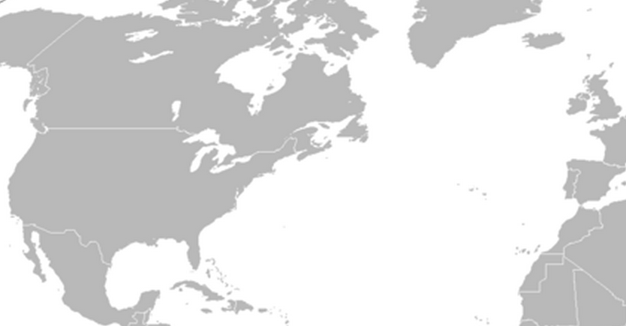
U. Manchester
Drexel
U. South Wales
National Science Digital Library
NSDL IPL Intute Total
98,507 40,973 124,070 263,550

Slide 4
Project Workflow
Databases:
MASH Metadata Aggregation Storage and Handling
DISTIL Document Indexing & Semantic Tagging Interface for Libraries
DRAMs Dynamic Representations of Annotated Metadata

Slide 5
Project Workflow
harvesting
Databases:
MASH Metadata Aggregation Storage and Handling
DISTIL Document Indexing & Semantic Tagging Interface for Libraries
DRAMs Dynamic Representations of Annotated Metadata

Slide 6
Project Workflow
harvesting
technical jiggery-pokery
Databases:
MASH Metadata Aggregation Storage and Handling
DISTIL Document Indexing & Semantic Tagging Interface for Libraries
DRAMs Dynamic Representations of Annotated Metadata

Slide 7
Project Workflow
harvesting
technical jiggery-pokery viz. tools
Databases:
MASH Metadata Aggregation Storage and Handling
DISTIL Document Indexing & Semantic Tagging Interface for Libraries
DRAMs Dynamic Representations of Annotated Metadata

Slide 8
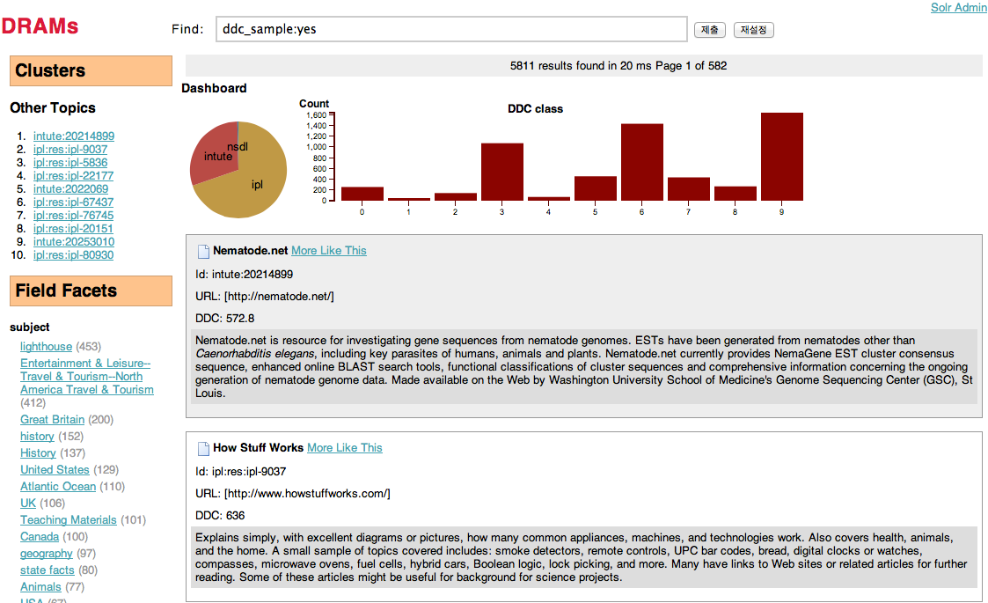
Dashboard

Slide 9
Network Analysis/Interactive Views
Build a DDC concept-to-concept graph in Gephi
Two nodes (concepts) are connected if their similarity score exceeds a certain threshold
Similarity scores calculated from the DDC codes retrieved from DISTIL
Export Gephi graphs into sigma.js – JS interactive browser
Users interact with the graph through the browser:
Overview → Show the distribution of all concepts and their structural/content-based clusters
Details → Selectively show the node labels
More details → By mouse over, show more detailed information of the nodes

Slide 10
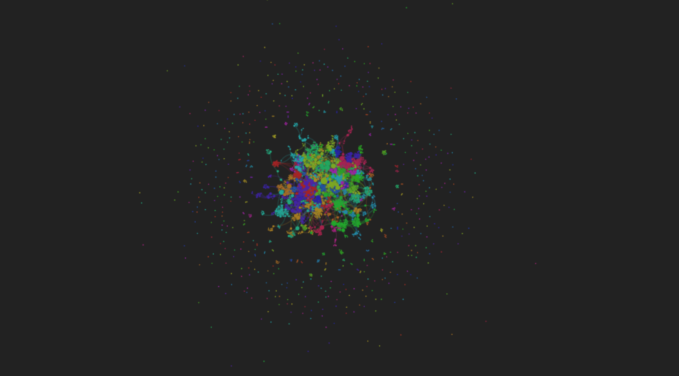
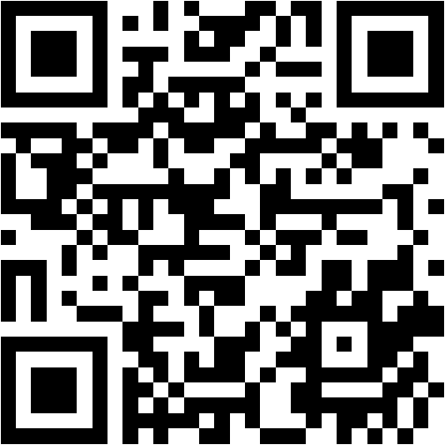
http://mcd.ischool.drexel.edu/ahn/digging-graph/
Network-based DDC browse

Slide 11
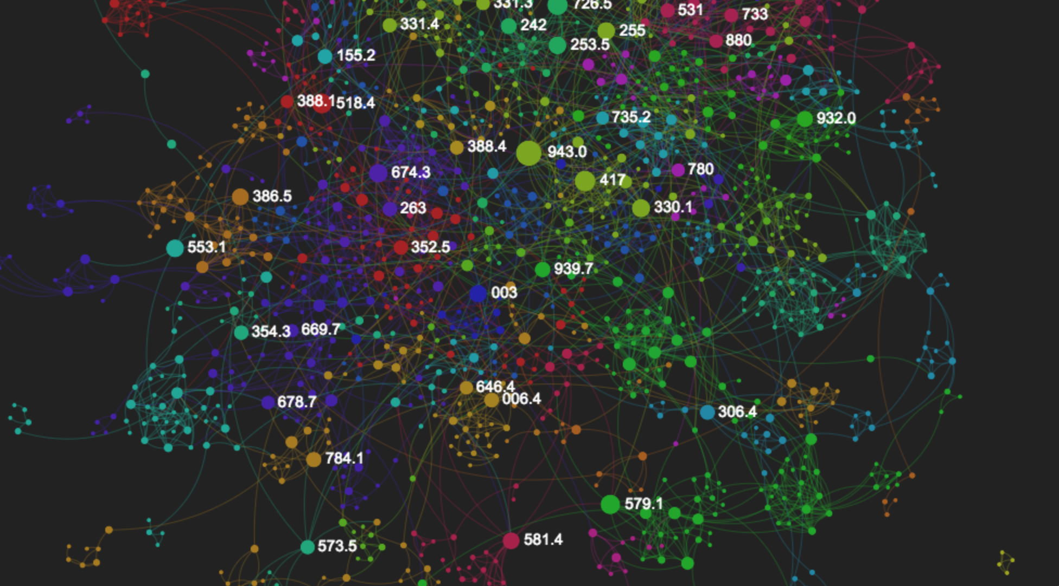
http://mcd.ischool.drexel.edu/ahn/digging-graph/
Network-based DDC browse

Slide 12
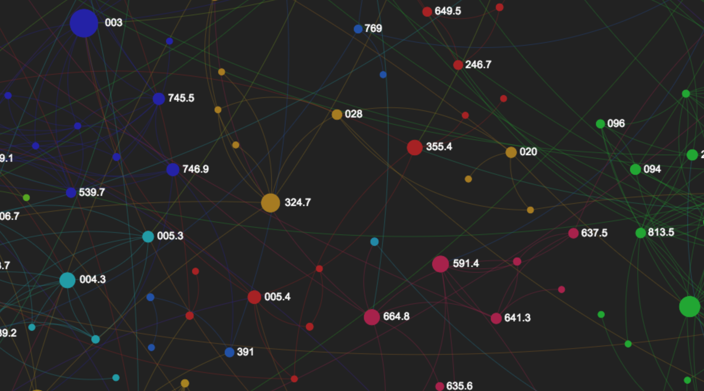
http://mcd.ischool.drexel.edu/ahn/digging-graph/
Network-based DDC browse

Slide 13
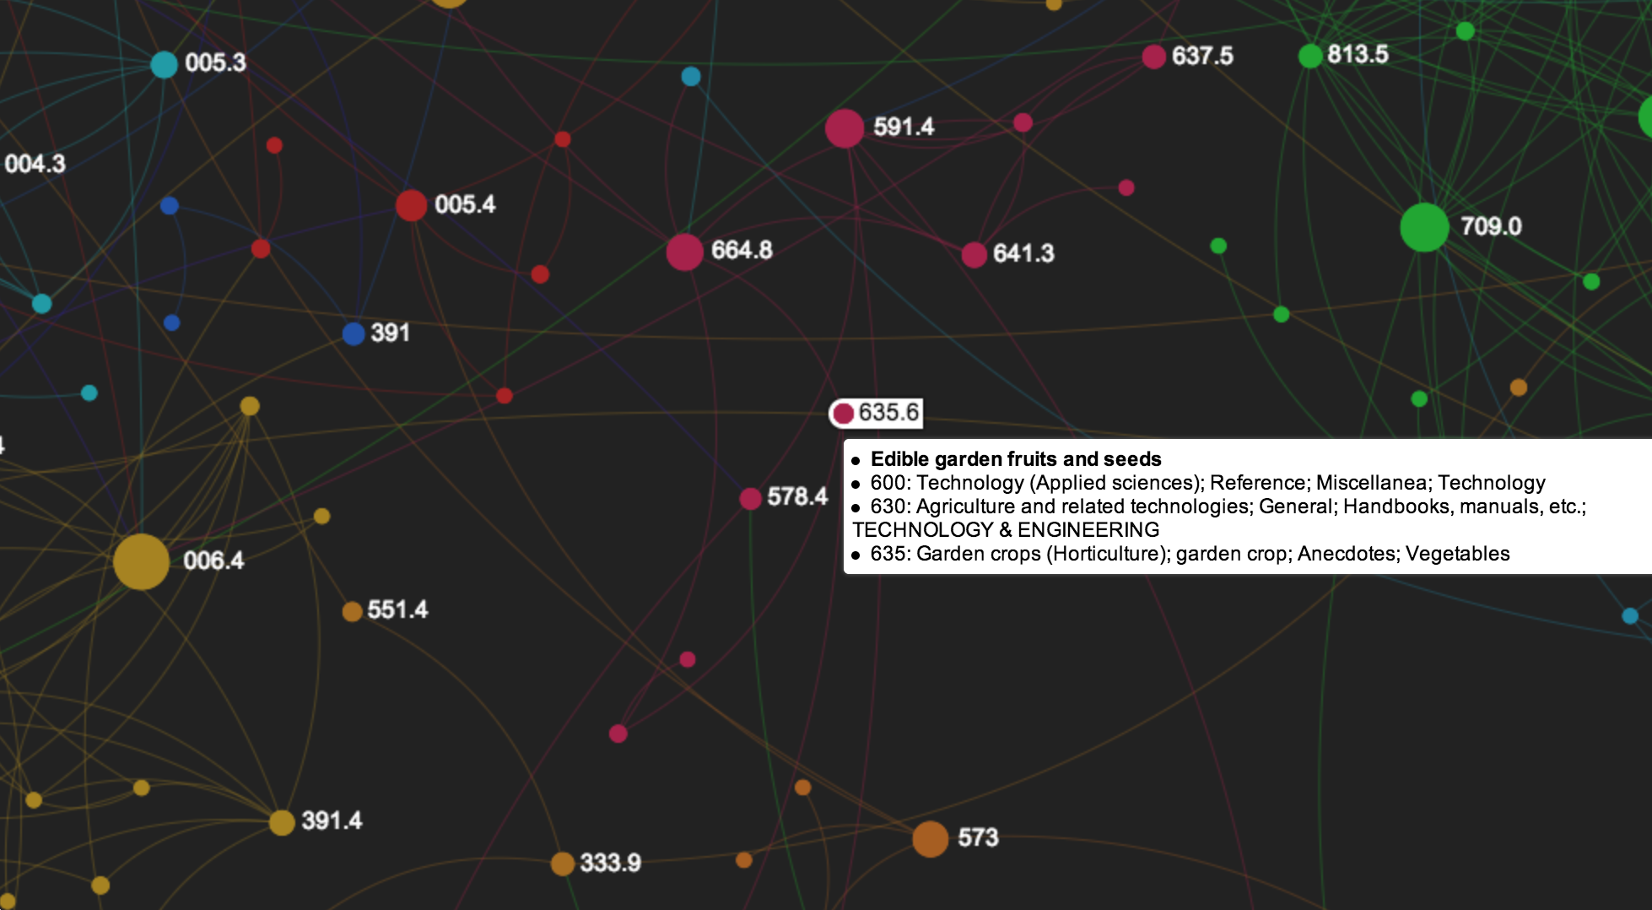
635.6 Edible garden fruits and seeds

Slide 14
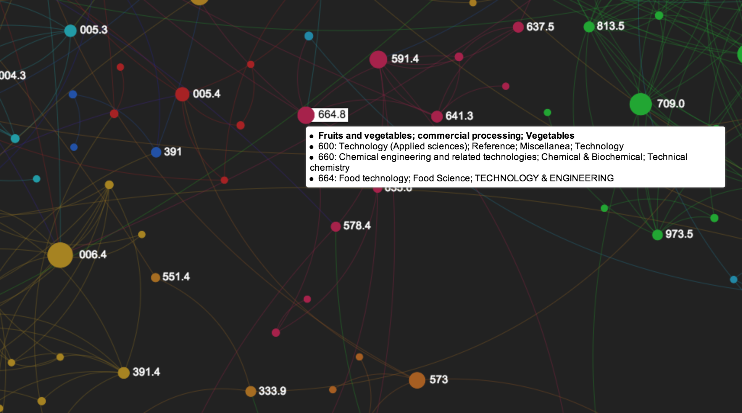
664.8 Fruits and vegetables; commercial processing

Slide 15
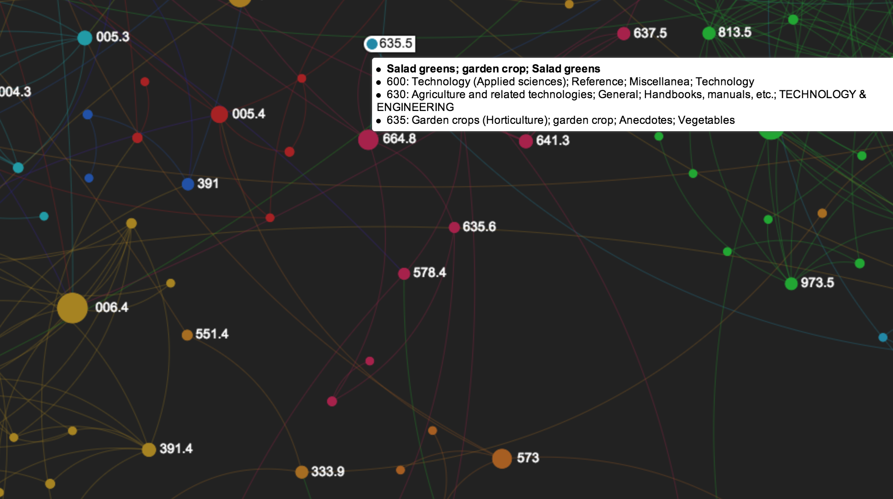
635.5 Salad greens; garden crop; Salad greens

Slide 16
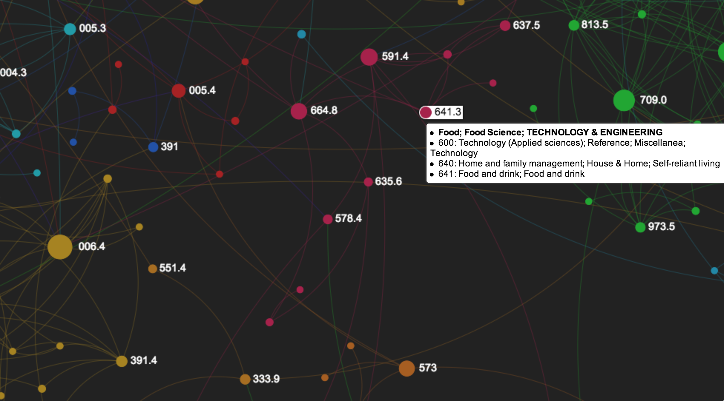
641.3 Food; food science; technology and engineering

Slide 17
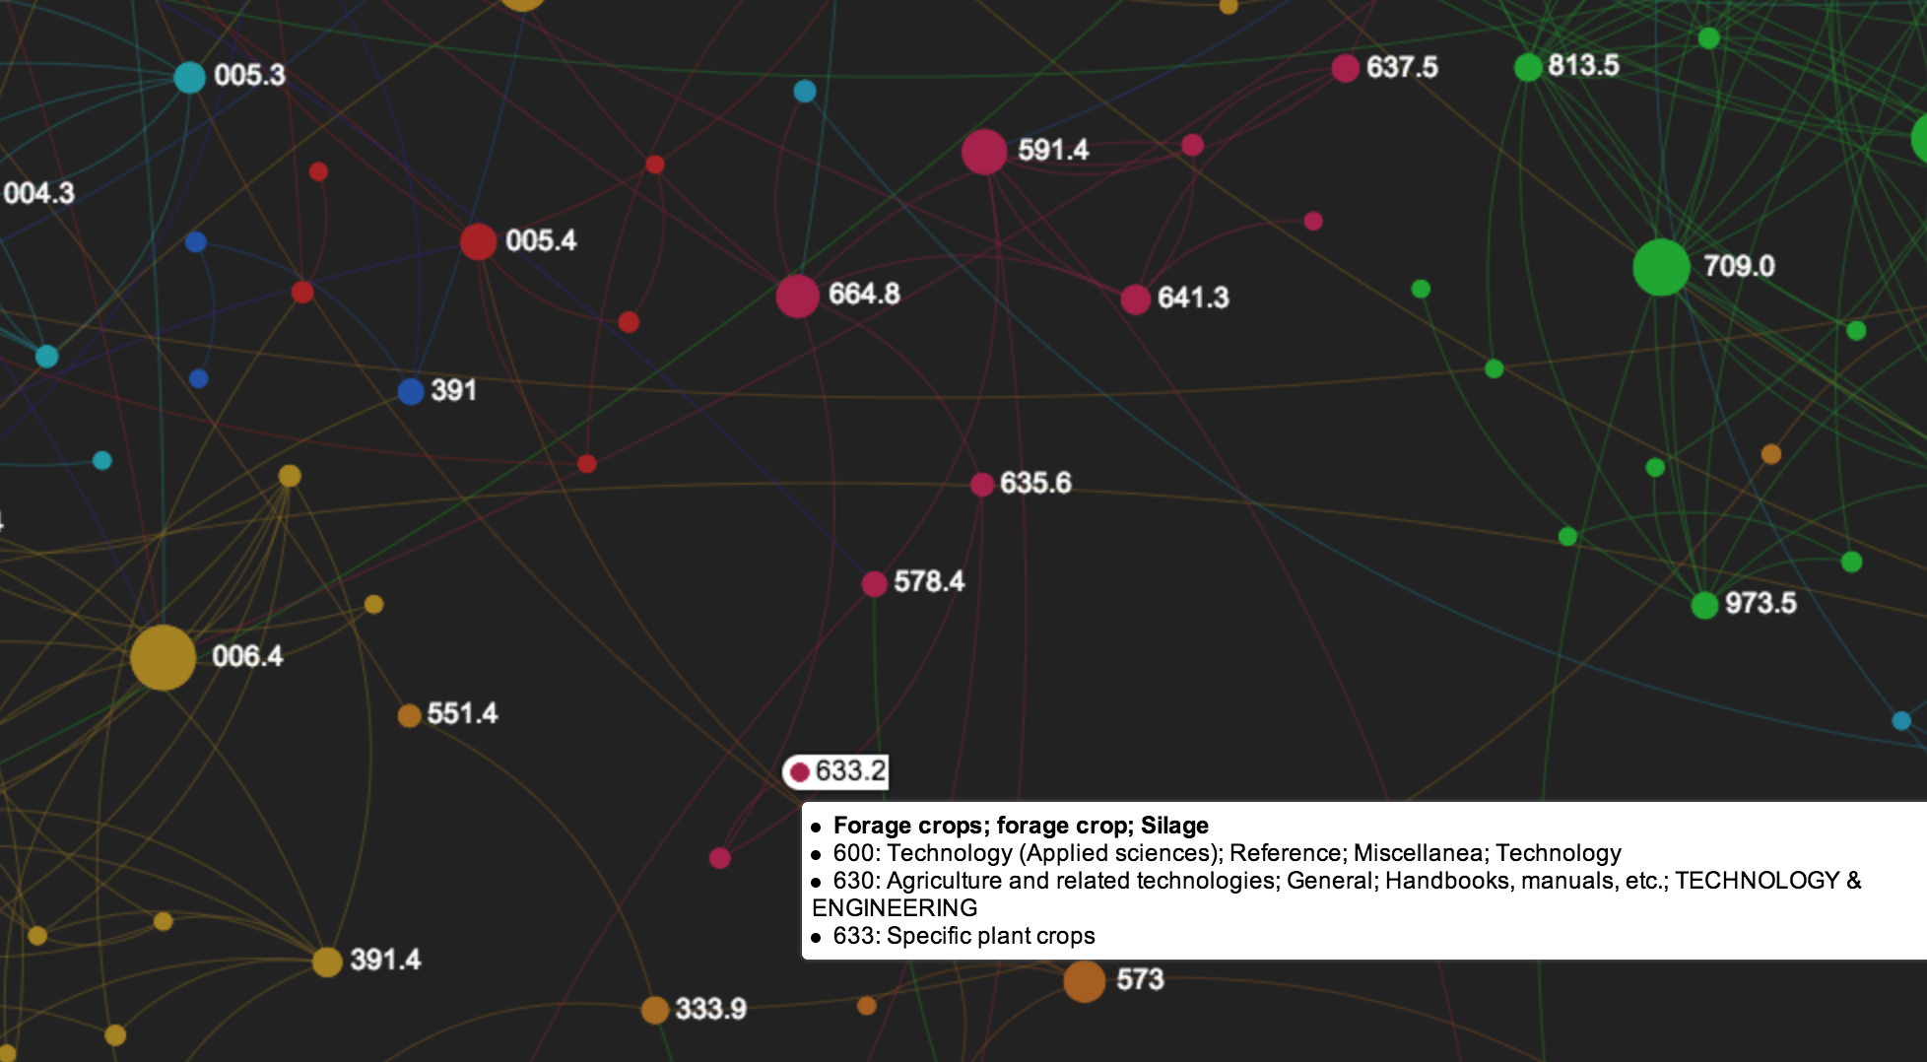
633.2 Forage crops; forage crop; silage

Slide 18
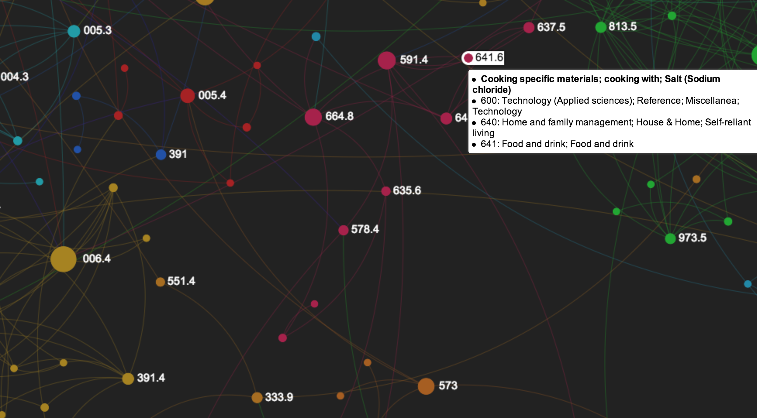
641.6 Cooking specific materials; cooking with; salt …

Slide 19
To Do
Systematic evaluation of individual project steps
What works, what does not
What is generalizable, extensible, scalable
Increase scope of technical jiggery-pokery (e.g. analyze full texts to produce browsable topic/subject-based network graphs)
Significant refinement of interface and usability
User studies, mental models

Slide 20
Lessons Learned
Collaboration takes a lot of work
Good project management is useful
Shared documents work really well
Structured meetings work really well
Face-to-face works really well

Slide 21
Early/Incremental Results
Binding, C., Tudhope, D., Ahn, J-W., Khoo, M., Lin, X., Massam, D., & Jones, H. (2013). Digging Into Metadata. 12th European Networked Knowledge Organization Systems (NKOS) Workshop at the TPDL Conference, Valletta, Malta, Thursday 26th September 2013.
Khoo, M., Ding, Y., Kowalczyk, S., & Mayernik, M. (2013). Managing Big Data and Big Metadata: Contributions From Digital Libraries. 2013 ACM/IEEE Joint Conference on Digital Libraries, Indianapolis, IN, July 22-26, 2013.
Khoo, M., Tudhope, D., Binding, C., Jones, H., and Orrego, I. (2013). OAI-PMH and Metadata Aggregation From Heterogeneous Digital Libraries: Three Case Studies. Conference Note: iConference 2013, Fort Worth, TX, February 12-15, 2013.
Khoo, M., Tudhope, D., Binding, C., Abels, E., Lin, X., & Massam, D. (2012). 'Towards Digital Repository Interoperability: The Document Indexing and Semantic Tagging Interface for Libraries (DISTIL). Theory and Practice of Digital Libraries (TPDL) 2012, Paphos, Cyprus, September 23-27, 2012.
Khoo, M. (2012). Digging Into Metadata. Invited panelist: "Library and Information Science in the Big Data Era: Funding, Projects, and Future." 75th Annual Meeting of the American Society for Information Science and Technology, Baltimore, MD, October 26-30, 2012.
Khoo, M., Tudhope, D., & Binding, C. (2012). Extracting Dewey Decimal Classifications from Dublin Core Metadata Records With the DISTIL Project: Preliminary Findings and Observations. Position paper: 11th European Networked Knowledge Organization Systems (NKOS) Workshop, Theory and Practice of Digital Libraries (TPDL), Paphos, Cyprus, September 23-27, 2012.
Khoo, M. (2012). Invited panelist: "Evaluating Digital Libraries - Methodologies and Challenges." Theory and Practice of Digital Libraries (TPDL), Paphos, Cyprus, September 23-27, 2012.

Slide 22
merci
thank you

Slide 23
Alternate Interface(s)

