Slide 1
Seeing Sonic: The PoemViewer Visualization Tool

Slide 2
“The constant happiness is curiosity.”
Alice Munro

Slide 3
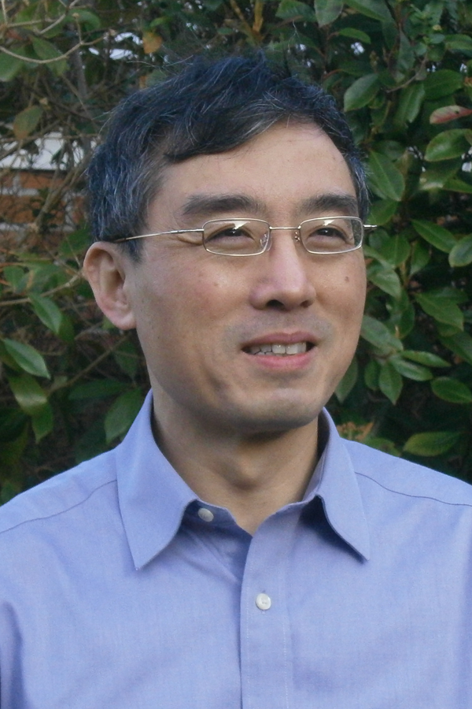
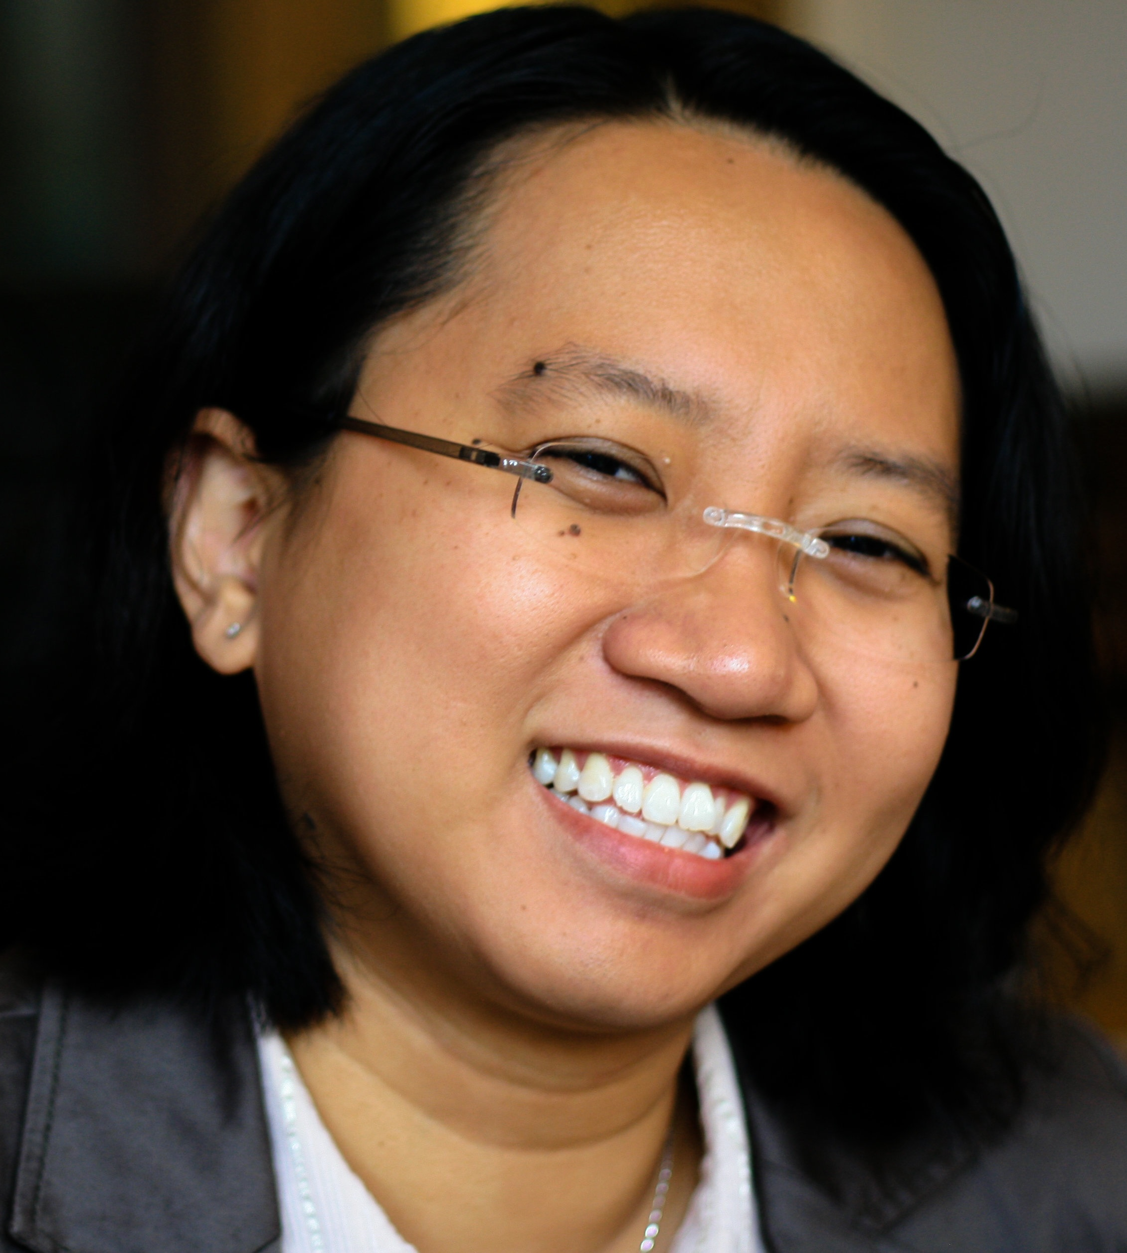

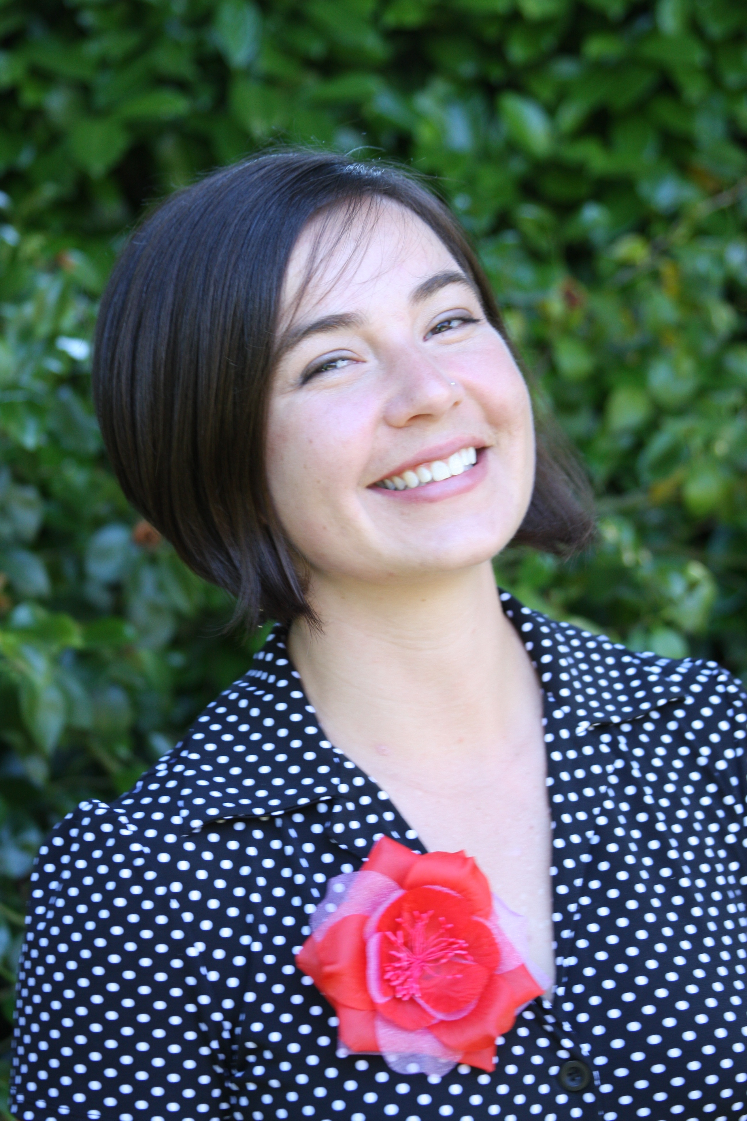




University of Oxford
Min Chen
Alfie Abdul-Rahman Eamonn Maguire Martin Wynne
University of Utah
Miriah Meyer
Christopher Johnson
Julie Lein
Katharine Coles

Slide 5
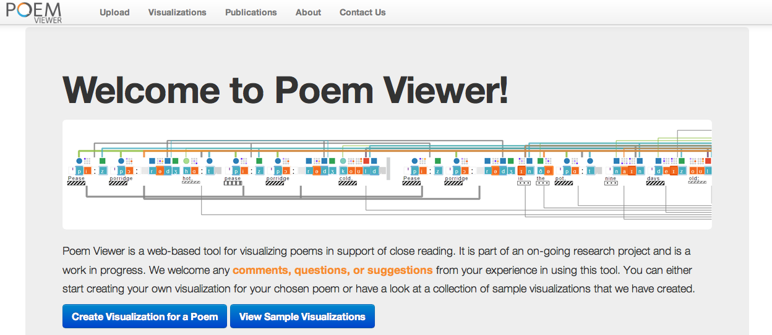
http://ovii.oerc.ox.ac.uk/PoemVis/

Slide 6
http://ovii.oerc.ox.ac.uk/PoemVis/

Slide 7
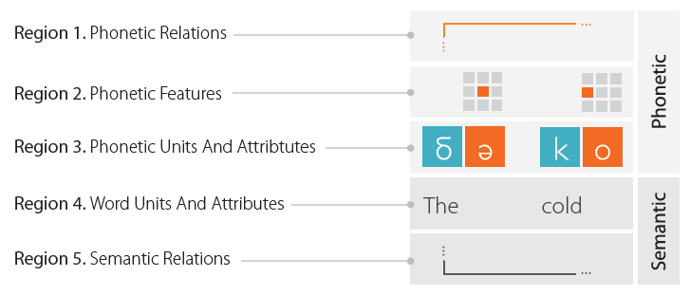
http://ovii.oerc.ox.ac.uk/PoemVis/

Slide 8
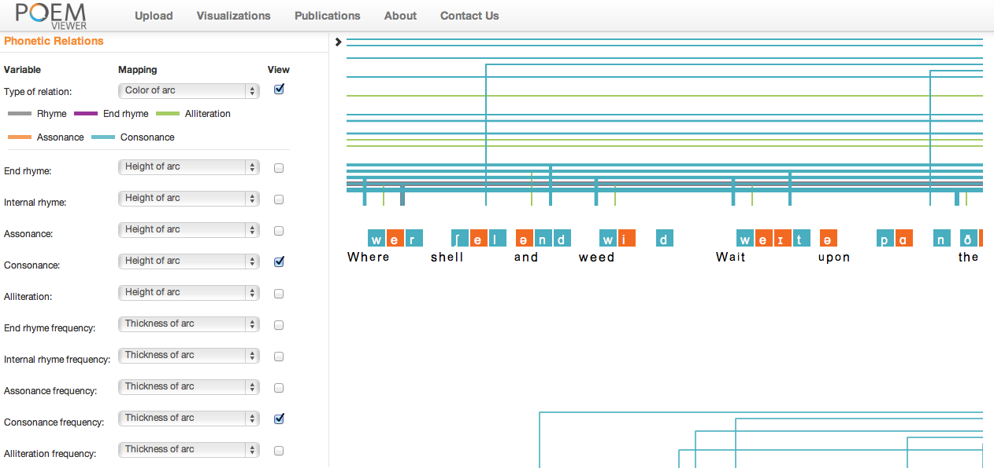


Slide 9
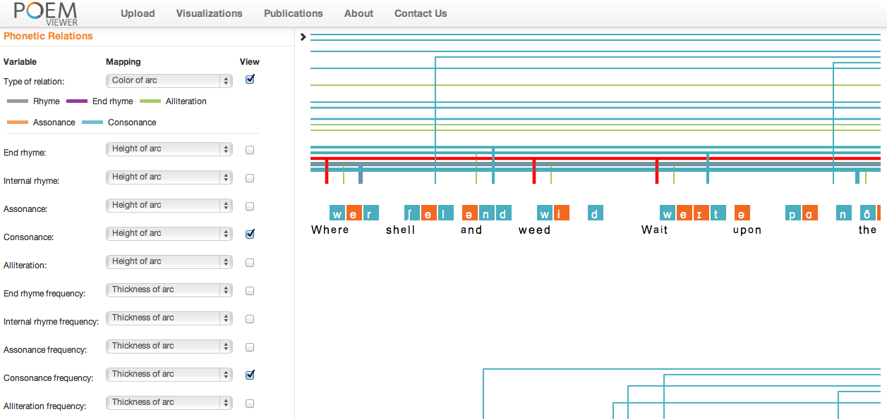

Slide 10
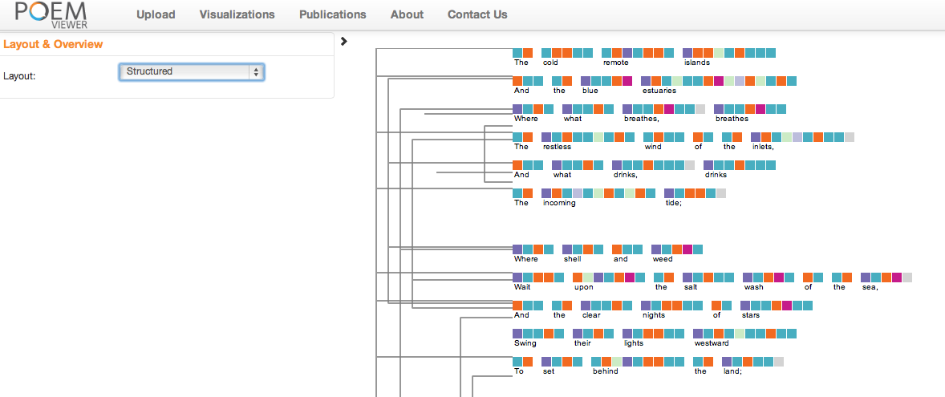
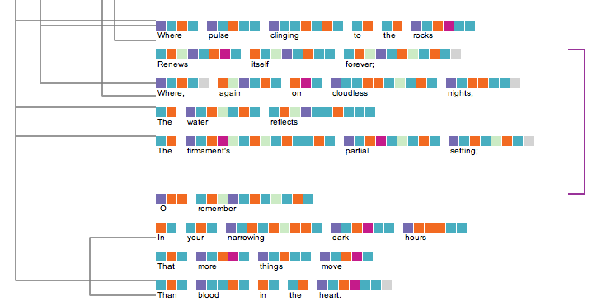

Slide 11
Glyph Design Mouth Placement
Showing:
Which part of the tongue is used
How high the tongue is raised
Whether lips are rounded or relaxed
Initial Design
Final Design
Rounded Lips
Relaxed Lips

Slide 12

Mouth Placement Transition
Movement from high-back, lips rounded to high-front, lips relaxed: e.g. “museum”

Slide 13
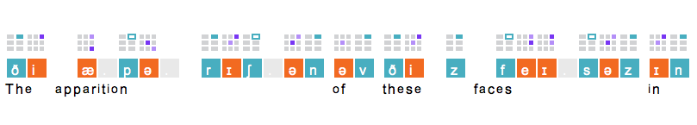
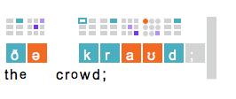
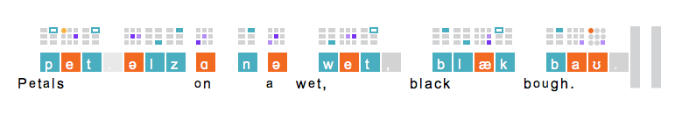
In a Station of the Metro
Ezra Pound

Slide 14
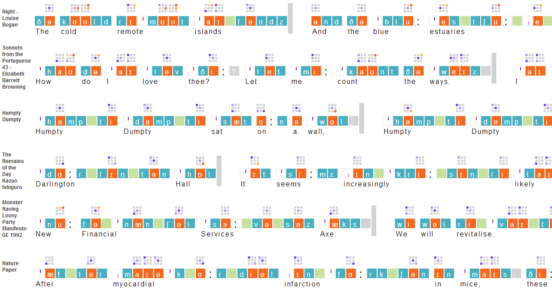

Slide 15
http://ovii.oerc.ox.ac.uk/PoemVis/
PoemVis is in beta and part of ongoing research
We welcome questions, comments, or suggestions about the software via the “contact us” form on the site
Funders include NEH, NSF, Jisc, SSHRC, IMLS, AHRC, ESRC, NOW
Additional support from the Oxford E-Research Centre, the SCI Institute, the University of Utah

