Slide 1
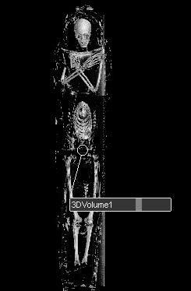

The IMPACT Radiological Database
Andrew J. Nelson, PhD
Associate Professor – Anthropology
Associate Dean – Research
Faculty of Social Science
The University of Western Ontario

Slide 2

The IMPACT Team
Canada
Cybulski, Jerome - Canadian Museum of Civilization/University of Western Ontario
Nelson, Andrew – University of Western Ontario
Wade, Andrew - University of Western Ontario
United States
Allam, Adel- Al Azhar Medical School, Cairo
Beckett, Ronald - Bioanthropology Research Institute at Quinnipiac University
Conlogue, Gerald - Bioanthropology Research Institute at Quinnipiac University
Finch, Caleb - University of Southern California.
Miyamoto, Michael- University of California, San Diego
Narula, Jagat - Mount Sinai School of Medicine
Sutherland, James - South Coast Radiological Medical Group
Sutherland, M. Linda - Newport Diagnostic Center
Thomas, Gregory - University of California, Irvine
Thompson, Randall- St. Luke's Mid America Heart Institute
Wann, Samuel- Wisconsin Heart Hospital

Slide 3
The Goal
to undertake broad scale examinations of
patterns of health and disease (this is not CIHR research!)
variability in the practice of mummification
in Ancient Egypt
across space and time

Slide 4
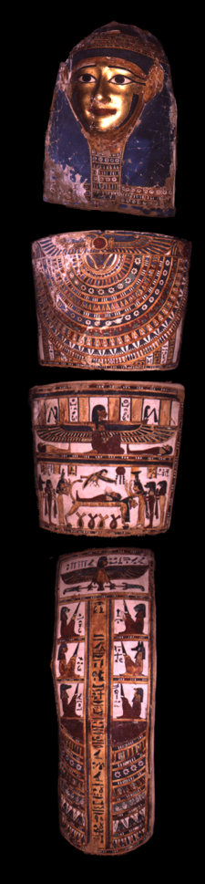
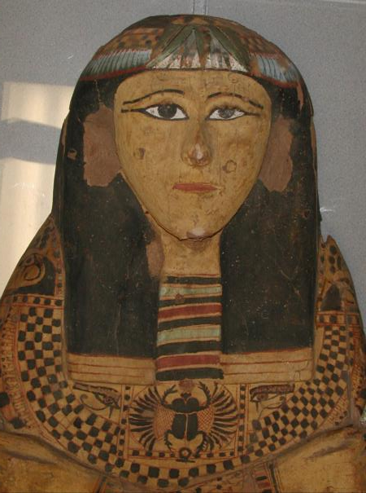
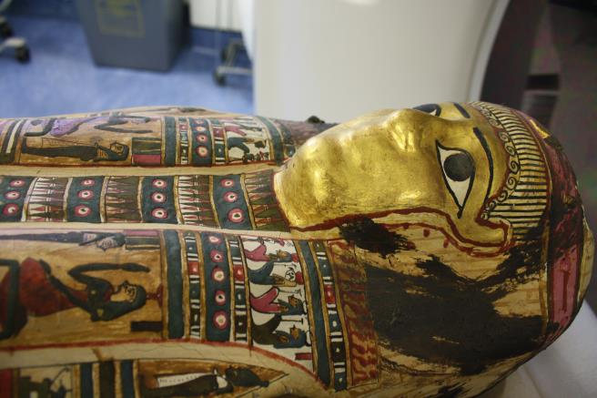
The Dataset
at least 1000 and as many as 10,0000
mummies preserved in museums worldwide
each mummy is a capsule of biological and cultural information

Slide 5
The Key Problems
the mummies are scattered throughout the world
analysis has – in the past – involved destructive techniques
The Mummy Autopsy
very informative but very destructive

Slide 6
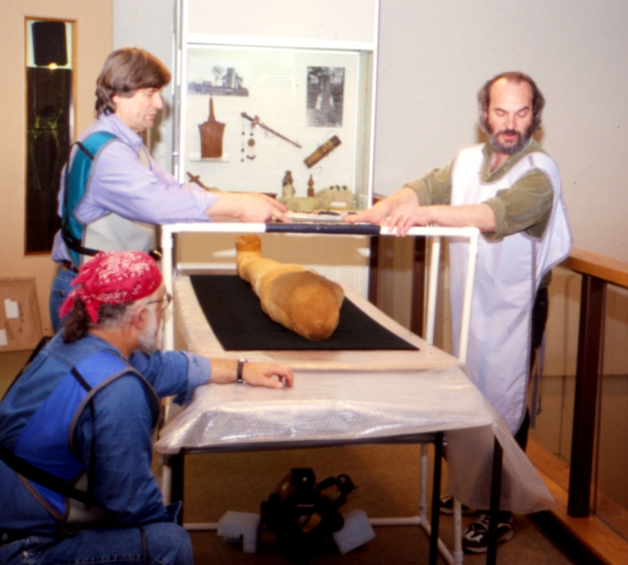
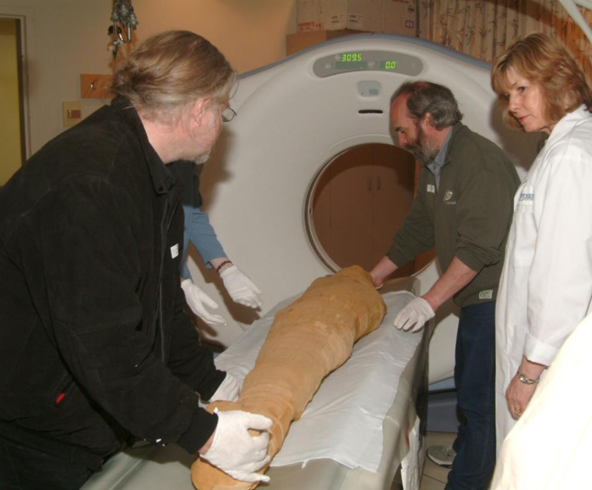
The Solution
Radiological Imaging Techniques =
Non-destructive Data Capture

Slide 7
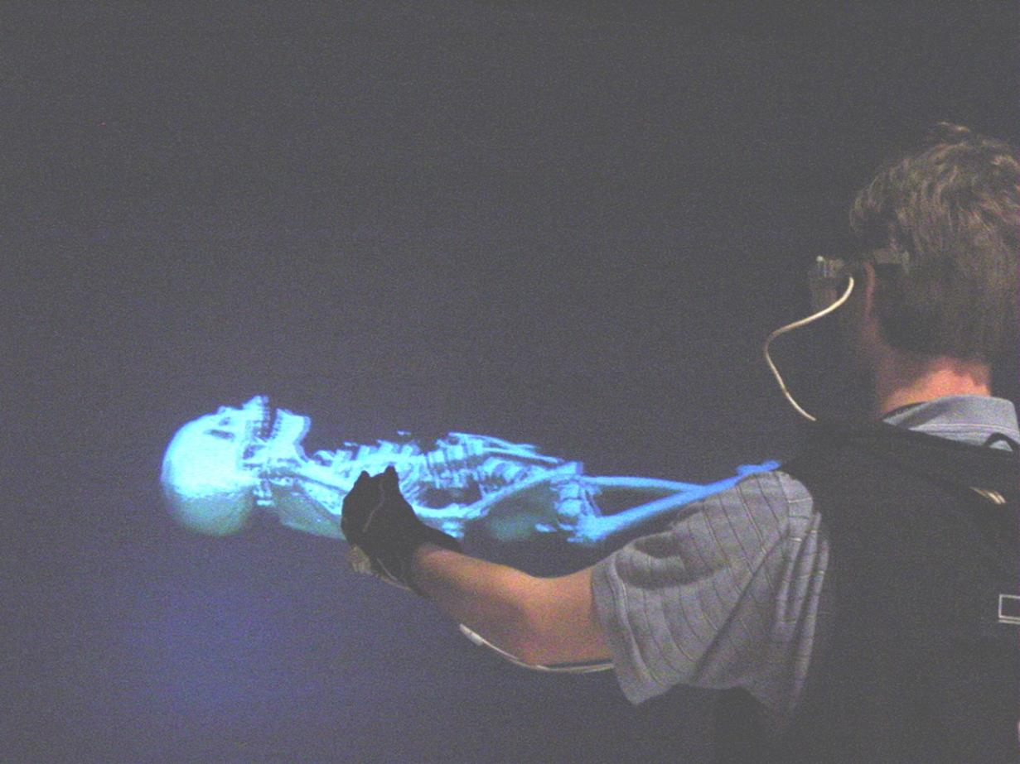
the virtual mummy

Slide 8
but we need to bring the radiological datasets together to allow us to move beyond the case study approach…
hence…
IMPACT
Internet based Mummy Picture Archive Communication Technology

Slide 9
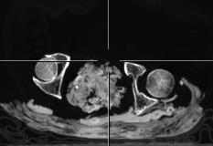
DICOM data
Digital Imaging and Communications in Medicine
metadata in a header
+
* 10s to 1000s of slices
= mega to gigabyte volumes

Slide 10
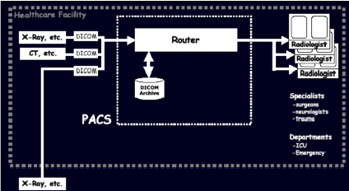
Picture Archive Communication System

Slide 11
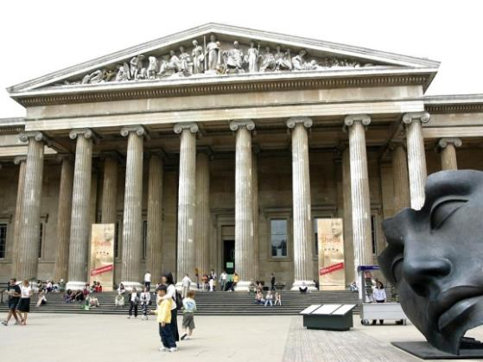

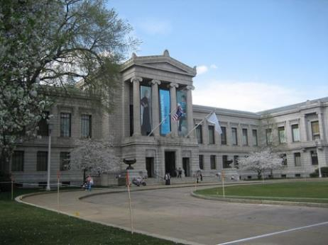
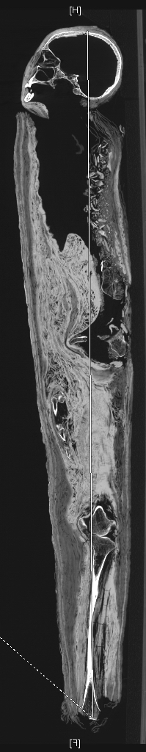
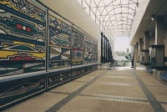
London
Data
base
Boston
Internet Mummy
PAC System
Tazmania

Slide 12
now more than 115 human datasets and 50 animal datasets
from Chatham, London (ON), Toronto, Montreal
and Chicago, Brooklyn, Pittsburgh, Denver…
and South Africa, France, Australia…
yields several hundred gigabytes of data now
- we have storage for 10 terabytes

Slide 13
Key Issue…
intellectual property

Slide 14
user community
access restricted to legitimate scientific applicants
unrestricted
access
the user community can also “push” data from a new study to the PACS
general sql database with contextual information and links to home institutions
PACS database with radiological data + manipulation software
Intellectual property: copyright resides with home institution; data is copied to the PACS server by agreement. Access is determined by application to an advisory panel. The thin client model means that only the images are served to the user, while the underlying data resides exclusively on the PACS server.

Slide 15
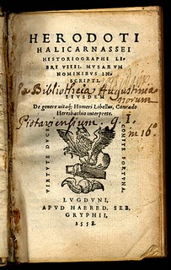
First steps…
Herodotus – 484 to 425BC
The Histories

Slide 16
Herodotus’ “recipe”
3 modes (price ranges)
“the most perfect” includes…
  removal of the brain through the nose
  incision along the left flank to remove the organs
  70 days in natron
descriptions generally include
  leaving the heart in the chest
  removal of the organs to canopic jars

Slide 17
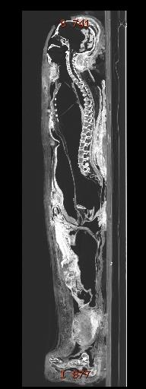
“Justine”
XXIst Dynasty
ca. 1000BC
still has her brain
and was completely
eviscerated (heart as well)
through her perineum

Slide 18

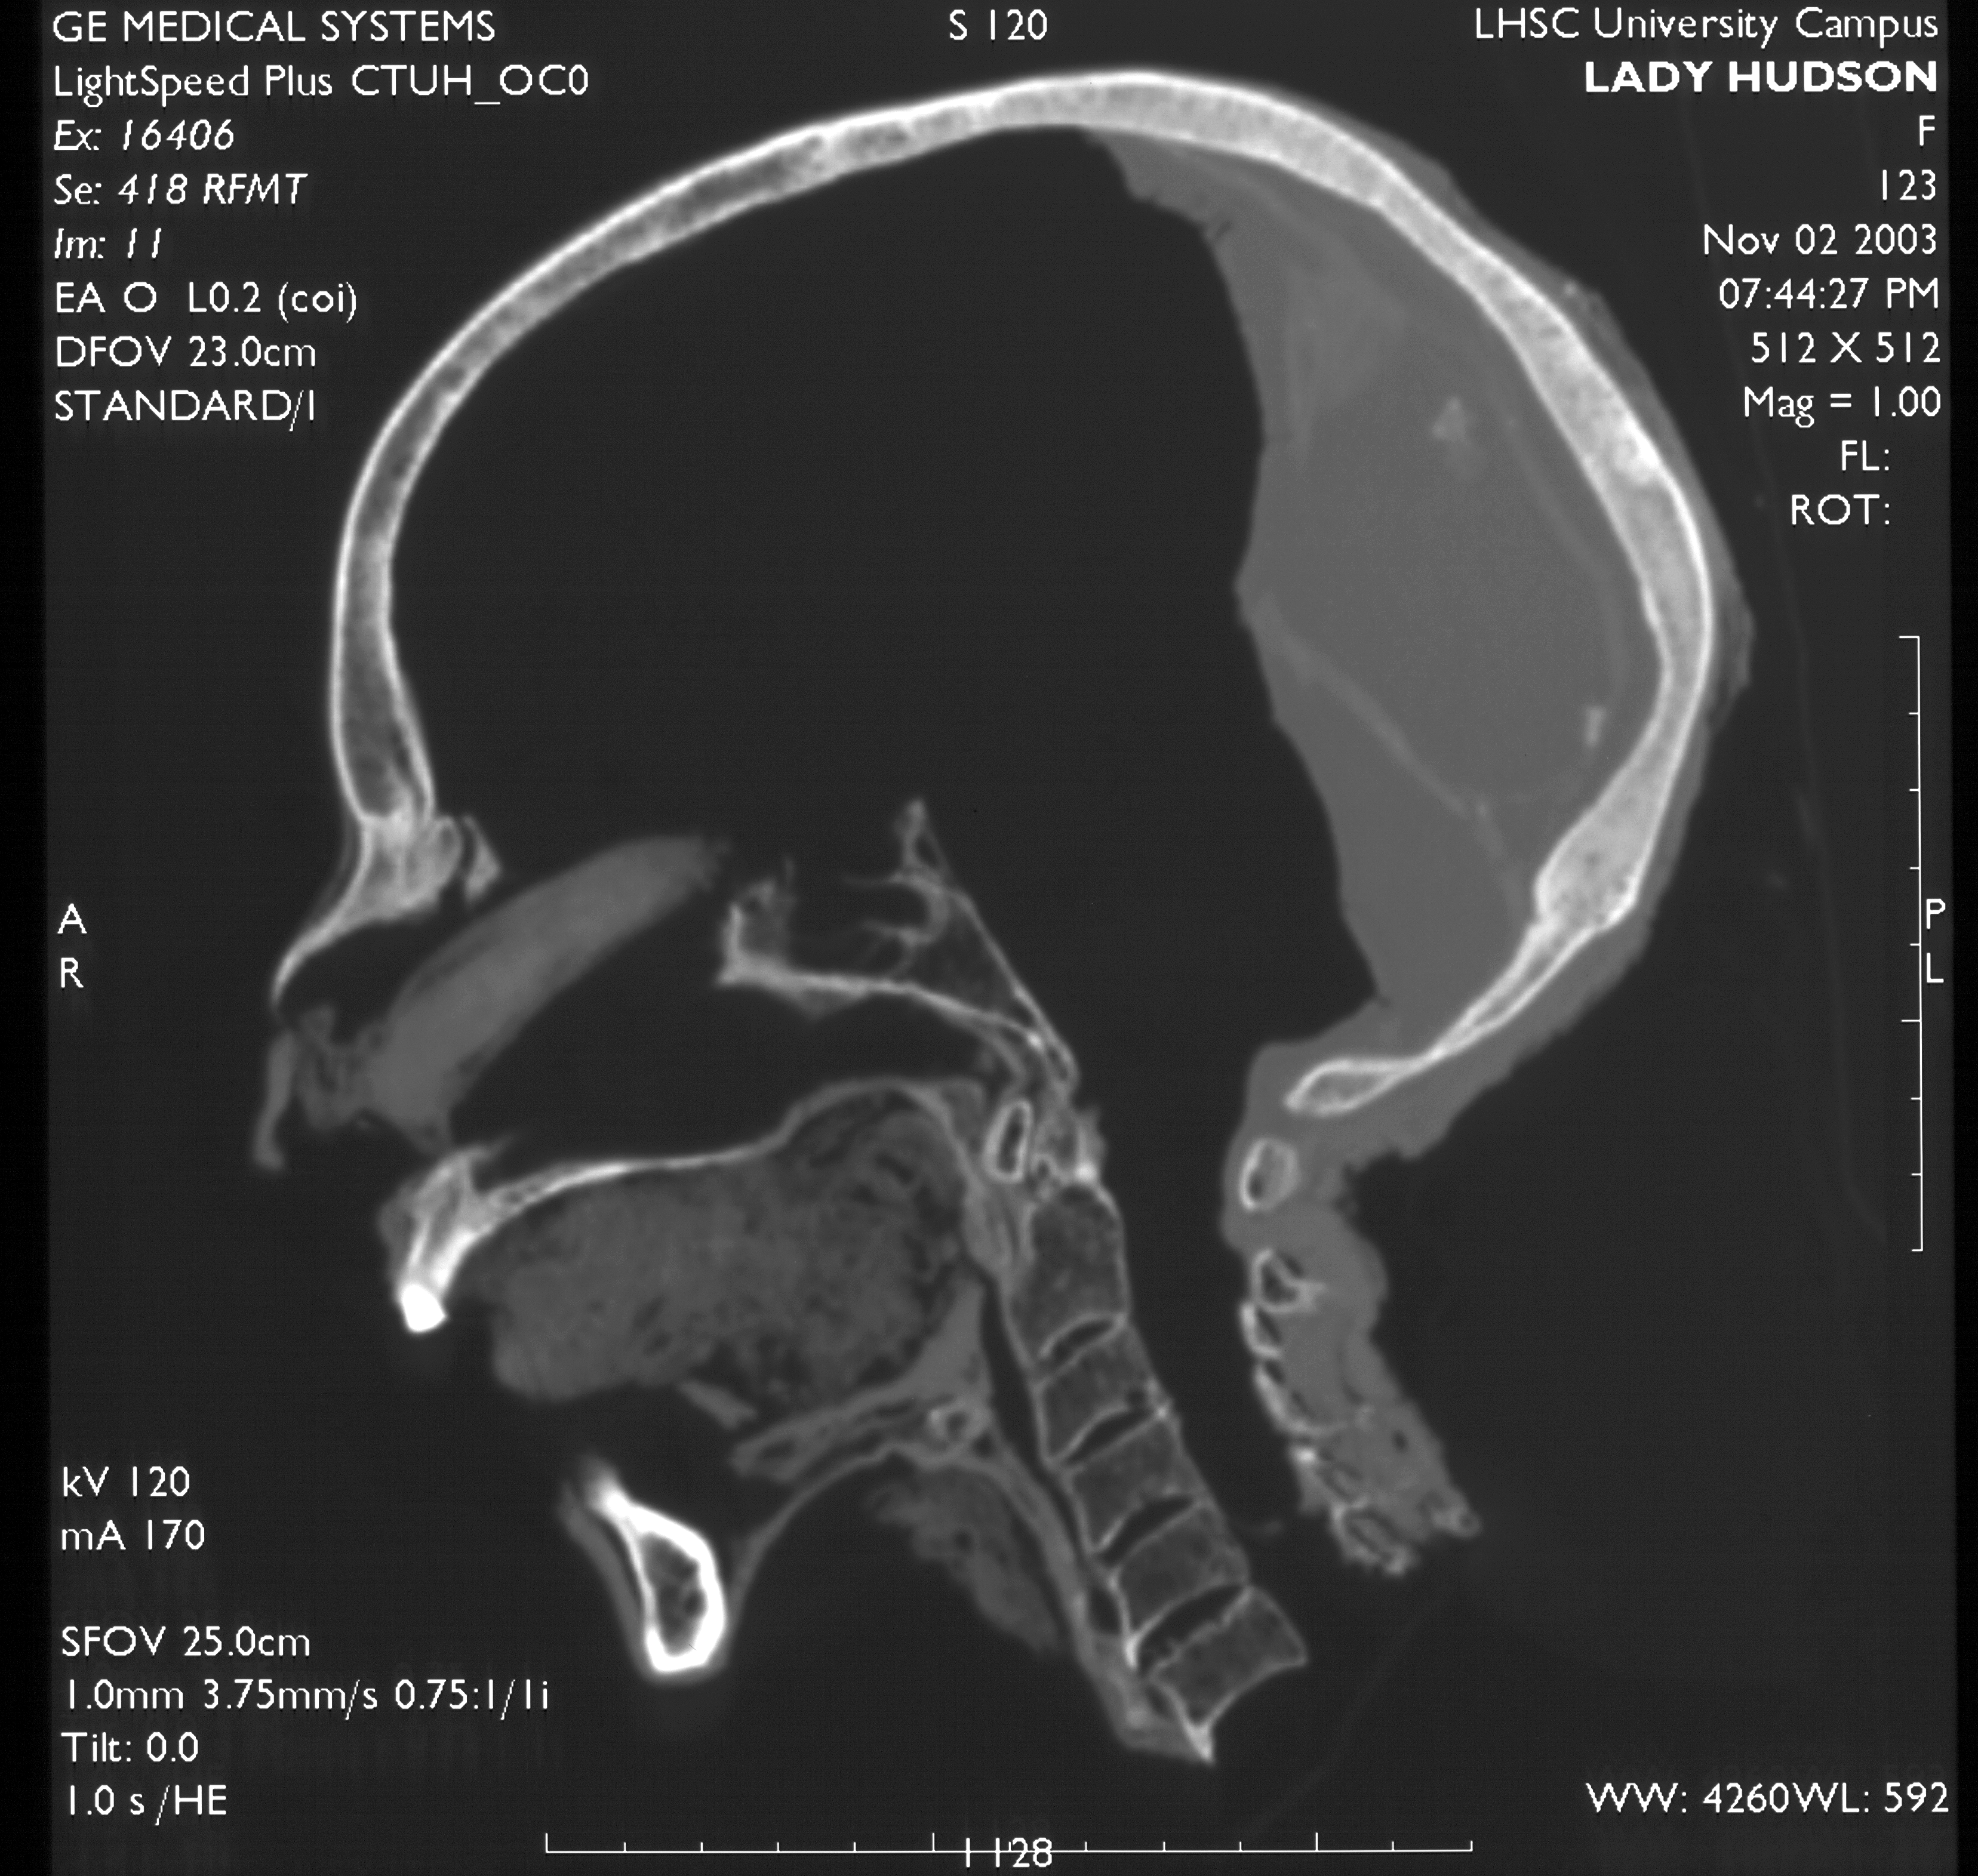
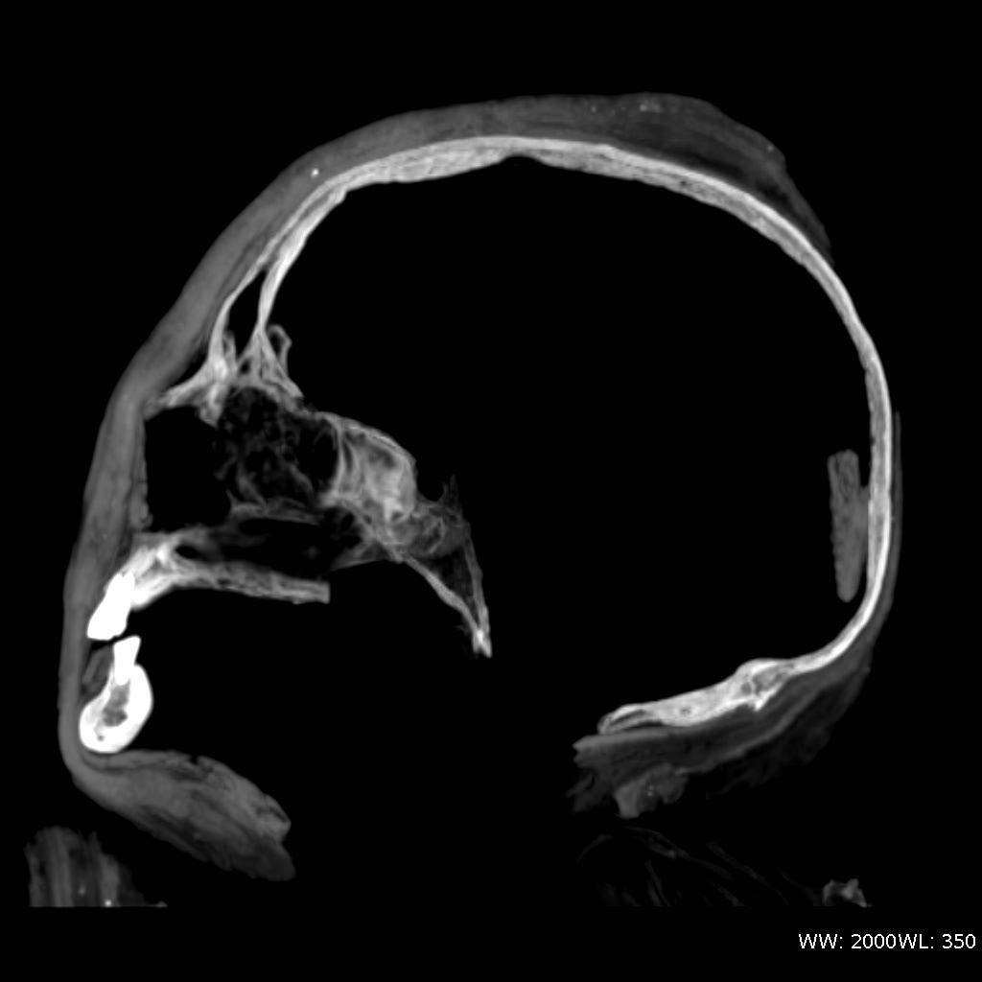
and…
lots of
variability
in brain removal

Slide 19
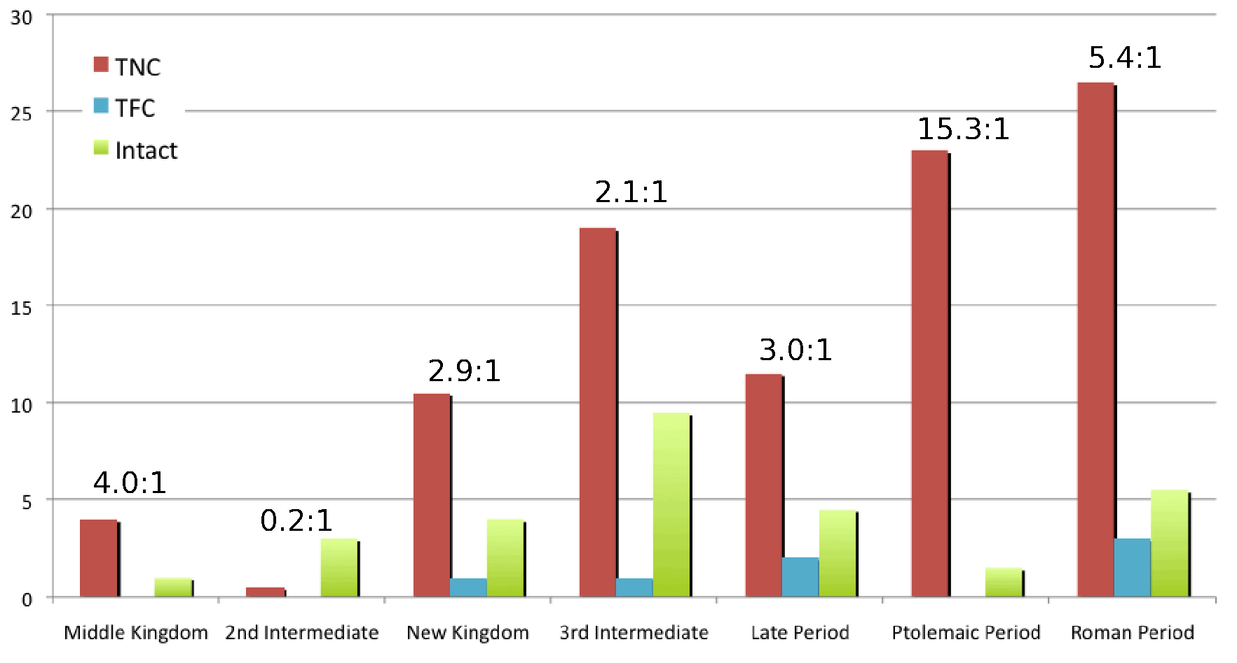
variability through time
Wade, A.D., Nelson, A.J & Garvin, G. 2011 A synthetic radiological study of brain treatment in ancient Egyptian mummies. HOMO: Journal of Comparative Human Biology 62(4): 249-269.

Slide 20
X

Slide 21
LiveScience – Ghose T. 2400-year-old myths of mummy-making busted.
Also run by Scientific American, Discovery News, MSNBC, Fox News, Huffington Post
22 March 2013.

Slide 22
to close…
this project has focused on mummies
but the technology and approach are generalizable to non-destructive imaging and archiving of cultural objects
the next slide shows a video made from microCT scans of a 16th century prayer bead from the Art Gallery of Ontario
see
http://ezine.codart.nl/17/issue/45/artikel/investigating-miniature-boxwood-carving-at-the-art-gallery-of-ontario-in-toronto/?id=119
the scans reveal hidden details about the construction of these elaborate works of art

Slide 23
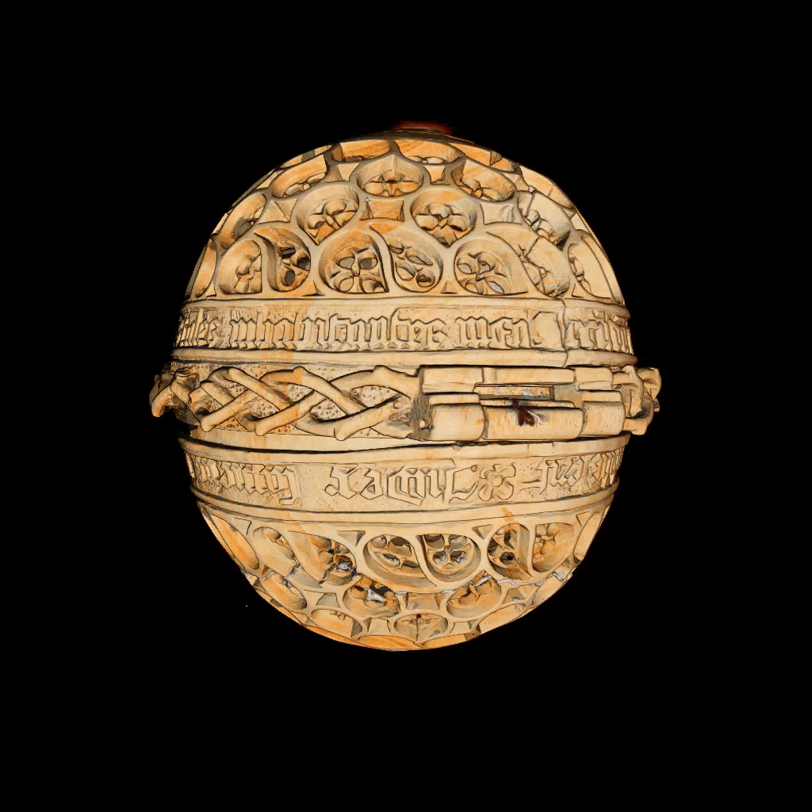

Slide 24
video credits:
Eric Fournier – ORS - http://theobjects.com/en/
Lisa Ellis, Sasha Suda – Art Gallery of Ontario
Prayer bead. AGO ID 29365. The Thomson Collection © Art Gallery of Ontario.
Andrew Nelson, Ron Martin, Zoe Morris,
Rhonda Bathurst
- Sustainable Archaeology, The University of Western Ontario - http://www.sustainablearchaeology.org/

