Slide 1
Trading Consequences:
Text-Mining for 19th Century Global Commodities
Bea Alex, Edinburgh University
Jim Clifford, University of Saskatchewan
Colin Coates, York University

Slide 2
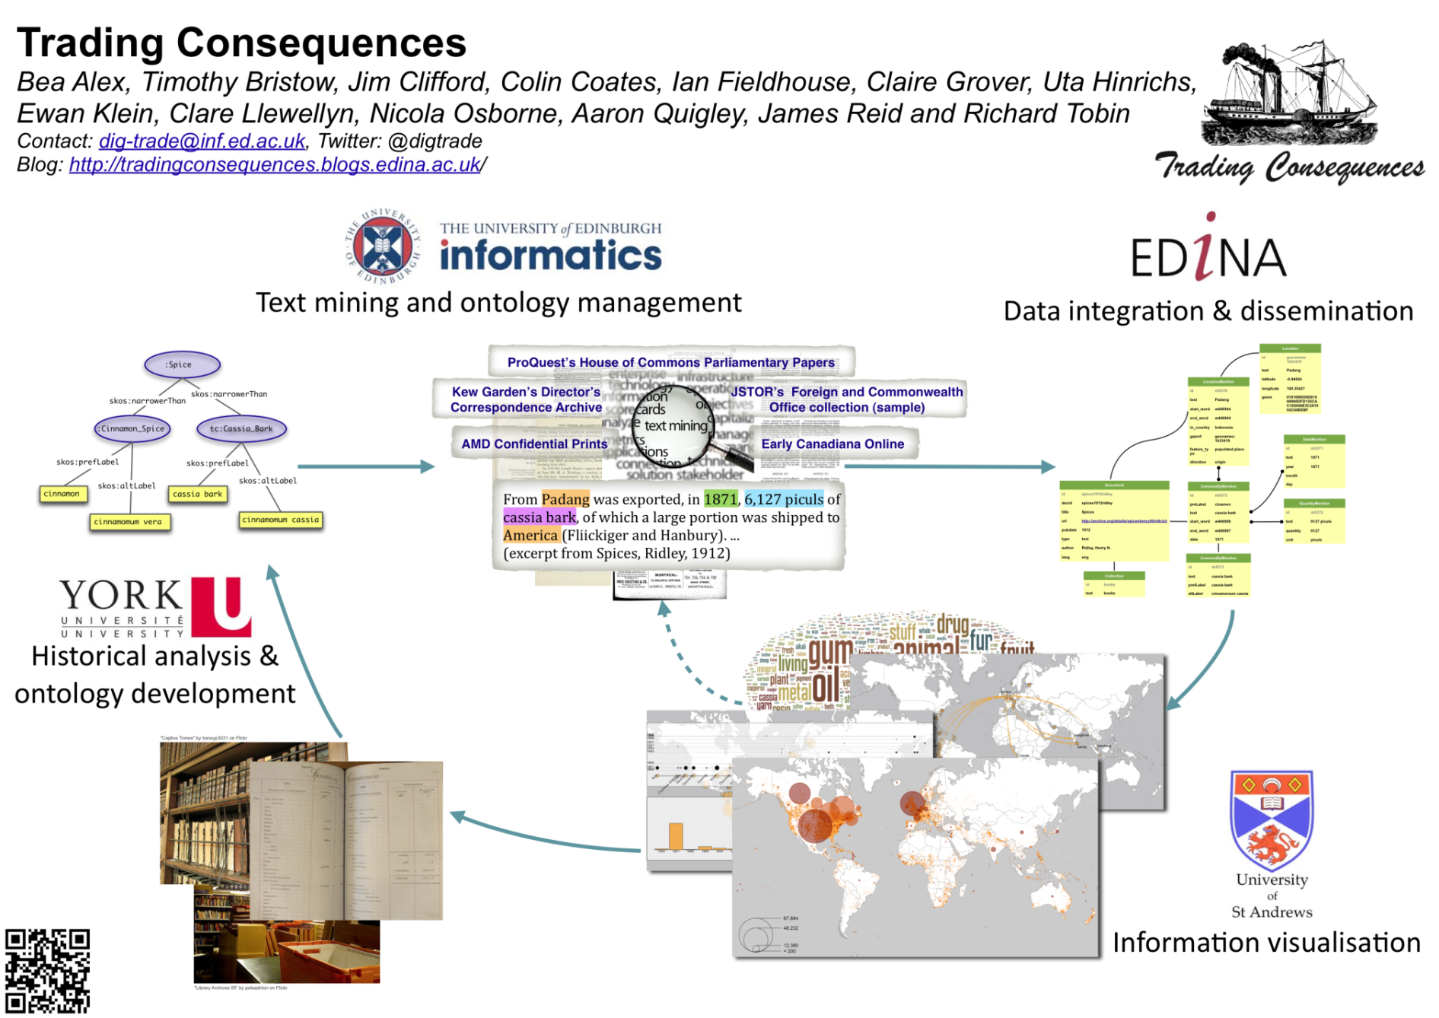


Slide 3
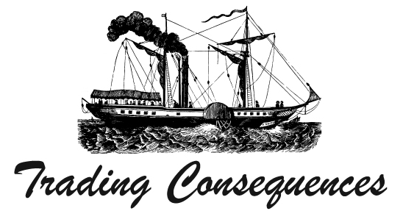
OCR Metadata from Online Collections
Collection | # of documents | # of images/pages
British House of Commons Parliamentary Papers (Proquest) | 118,526 | 6,448,739
Early Canada Online (Canadiana.org) | 83,016 | 3,938,758
Kew Gardens Letters | 14,340
Confidential Prints Collection (Adam Matthews Online) | 1,315 | 140,010
Foreign and Commonwealth Office Collection (Jstor) | 1,000 | 41,611
Asia and the West: Diplomacy and Cultural Exchange (Gale) | 4,725 | 948,773 OCRed: 450,841
Notes:
Over 11 million pages of historical documents, with adds up to more than 7 billion words

Slide 4
Text Mining
Named Entity Recognition
  Place names
  Commodities
  Dates
Relation Extraction
  Finding relationships between commodities, locations and dates
Entity Grounding
  Identifying the correct location of a place name
Notes:
Jim

Slide 5
Entity Grounding
Edinburgh Geoparser used to resolve location mentions in text.
All recognized locations are grounded with lat/long coordinates.
Each text is treated as a coherent whole and all location mentions in it contribute to the resolution of the others.

Slide 6
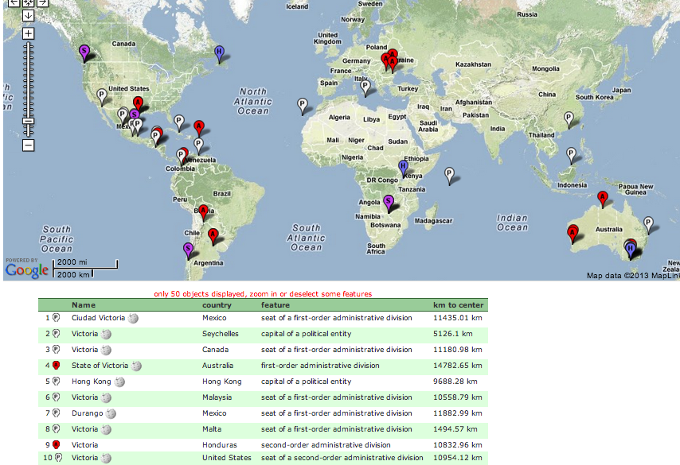
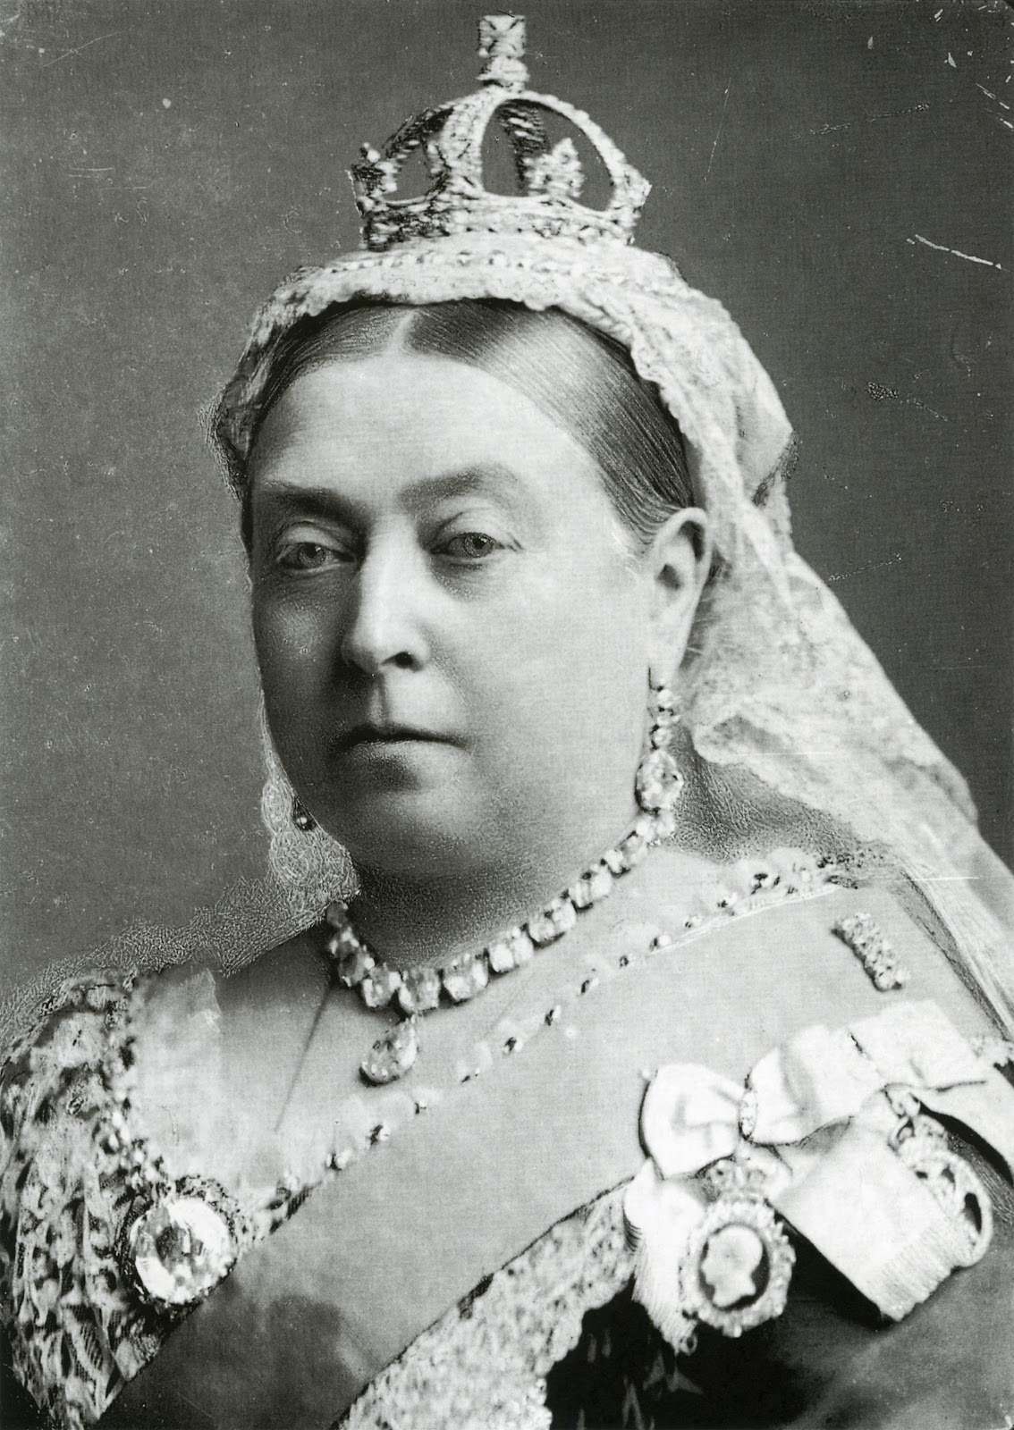
Entity Grounding

Slide 7
Text Mining and Geo-Referencing
Example sentence:
Holtze, 1891 (jstor: 60229554): The road leads from Bandong on a well kept but rather steep road upward on the mountain, Tangkoeban Praoe, so called (overturned boat) from its shape, on the side of which the Government cinchona plantations, Lembang and Nakrak […] are situated.
Notes:
Ewan

Slide 8
Text Mining and Geo-Referencing
Example sentence:
Holtze, 1891 (jstor: 60229554): The road leads from Bandong on a well kept but rather steep road upward on the mountain, Tangkoeban Praoe, so called (overturned boat) from its shape, on the side of which the Government cinchona plantations, Lembang and Nakrak […] are situated.
Notes:
Ewan

Slide 9
Text Mining and Geo-Referencing
Example sentence:
Holtze, 1891 (jstor: 60229554): The road leads from Bandong on a well kept but rather steep road upward on the mountain, Tangkoeban Praoe, so called (overturned boat) from its shape, on the side of which the Government cinchona plantations, Lembang and Nakrak […] are situated.
Extracted:
commodity-location relation: cinchona-Bandong (lat: 0.53333; long 103.3; Indonesia)
commodity-date relation: cinchona-1891 (pubdate)
Notes:
Edinburgh Geoparser used to resolve location mentions in text.
All recognized location mentioned are grounded to a unique GeoNames ID with lat/long coordinates.
Each text is treated as a coherent whole and all location mentions in it contribute to the resolution of the others.

Slide 10
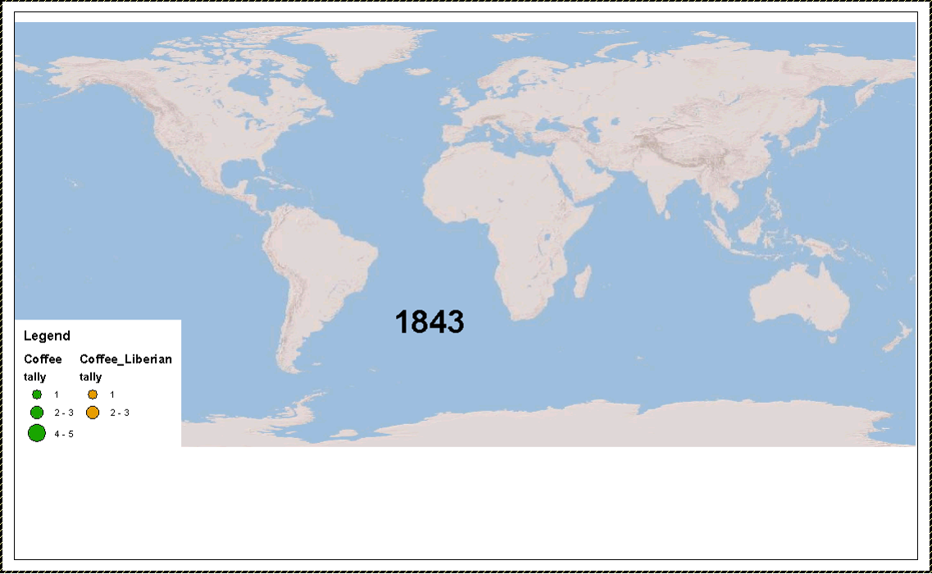
Two Coffees

Slide 11
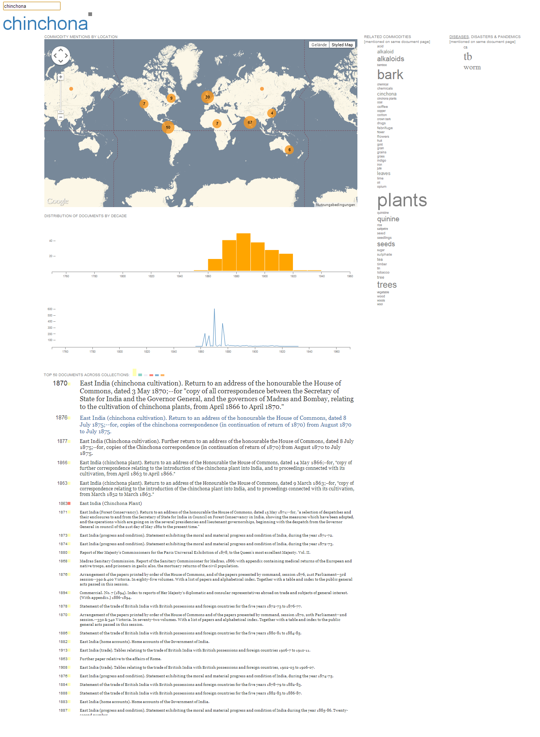

Slide 12
Summary
Geo-parsing is an important step in historical text mining.
Inter-disciplinary collaboration valuable for digital humanities.
Semi-automatic development of commodity lexicon.
Feedback to improve technologies.
Learning to ask new questions.

Slide 13


Funding provided by Trading Consequences,
a Digging into Data Project
Notes:
To conclude:
Technology, consumer culture, capitalism and imperialism combined to increase soap and candle production in Britain. These industries significantly increased Britain’s reliance on “ghost acreage” in distant ecosystems to supply the necessary animal and vegetable fats. Technological innovations played an important role, increasing the scale of production, improving the quality of the product and contributing the reduced cost for consumers. Consumer culture, particularly the middle class embrace of hyper-cleanliness, created a significant stimulus on the demand side.
The diverse global supply of fats from the Eurasian Steppe to the South Island of New Zealand, provides a clear example of the formation of the British world-system during the nineteenth century. Focusing on the formal Empire alone ignores the significant economic and environmental consequences British demands for raw materials had on commodity frontiers located in many parts of the world’s map not ‘painted red’ even during the height of the Empire.
The Empire did provide a large portion of the fats supply by the century’s end. Australasia came to dominate the tallow trade and helped drive the prices for this essential commodity down to record lows in the 1890s. During the middle of the century, Sri Lanka’s coconut oil provided an essential raw material for candle making. India contributed large quantities of flax seeds. Egypt became a major supplier of cottonseeds.
All together, British economic and political power combined to open up the world’s agricultural landscapes to supply soap and candle makers in London and Liverpool with an increasingly inexpensive array of fats.

Slide 14
